Slide 1
Priorities queues and heaps
By Brandon Sommerfeld

Slide 2
The priority queue interface
Abstractly, a priority queue is just any kind of data structure where we can insert elements, and remove the highest priority element
The client must define this priority function: in a min heap, small numbers have higher priority, while in a max heap it is the big number

Slide 3
Example: A hospital
In a hospital, people need to be treated in some order. People who have really severe conditions need to be treated immediately, but everyone else is served in the order that they arrived

Slide 4
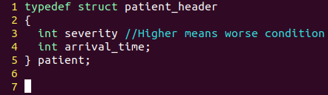
For this example, suppose the threshold of severity is 10: everyone above a 10 is in critical condition and must be helped ASAP, and higher numbers mean they are even more important, but everyone 10 or below is okay to wait
We will create our priority function, which is true if x has strictly higher priority than y.

Slide 5
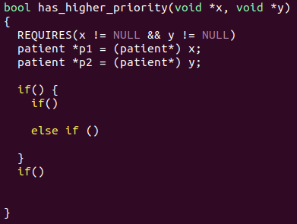

Slide 6
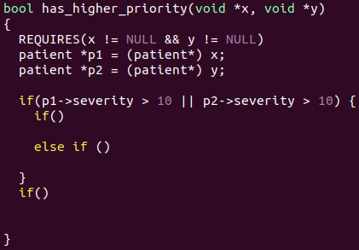
If someone is is really bad condition, we want to take them without even looking at arrival time

Slide 7
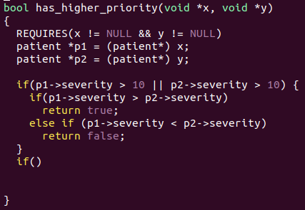
We want to take the patient with higher severity. But what if both have the same severity?

Slide 8
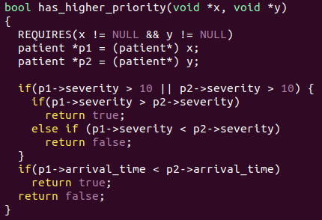
We take the patient who arrived earlier in that case.

Slide 9
Implementing priority queues with heaps
We can view a heap as a tree, and we impose an ordering invariant and a shape invariant to ensure operations are efficient
Ordering invariant: every node has greater or equal priority than its children, or equivalently no node has greater priority than its parent
Shape invariant: we fill in the tree 1 layer at a time, from left to right

Slide 10
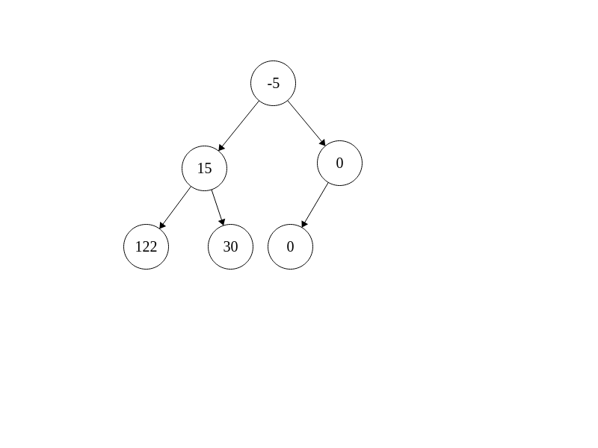
Here is a valid min heap, where small numbers have high priority. No child is smaller than its parent, and we fill in 1 layer at a time

Slide 11
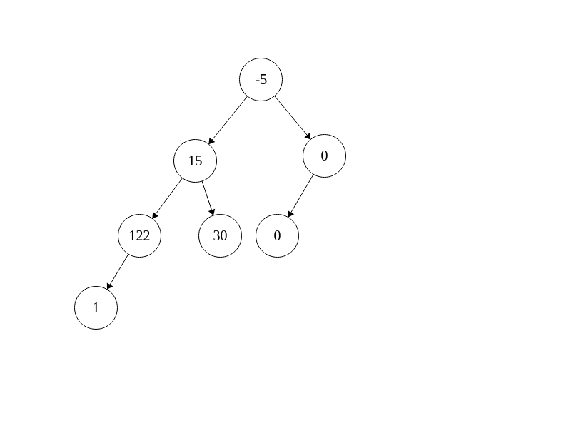
This is invalid: we violate both the ordering invariant with 1 smaller than 122, and we violate the shape invariant because we did not fill in the third layer before starting a new one

Slide 12
Insertion
Suppose we want to insert -1 into this heap. We actually do the opposite of AVL trees for this: in AVL trees, we kept the order invariant, and then fixed the height violations.
Here, we keep the shape invariant, and fix any order invariant violations which occur.

Slide 13
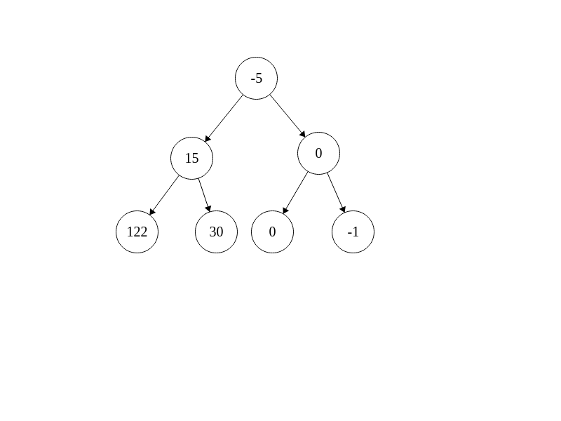
Insertion
We put our element in the next available spot. Now we have ordering violations though. To fix this, we swap our insertion element up the heap until there are no more violations

Slide 14
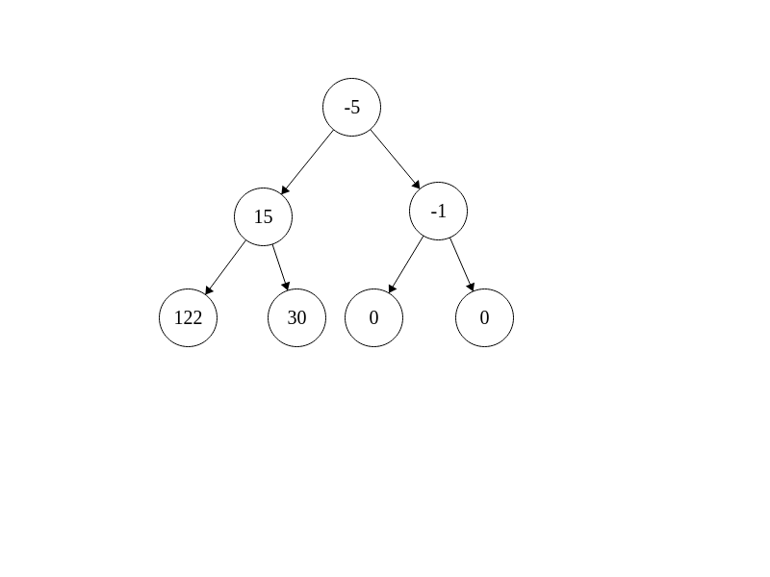
Insertion
Once we get here, we check -1 against -5, but that is okay, so we are done sifting up.

Slide 15
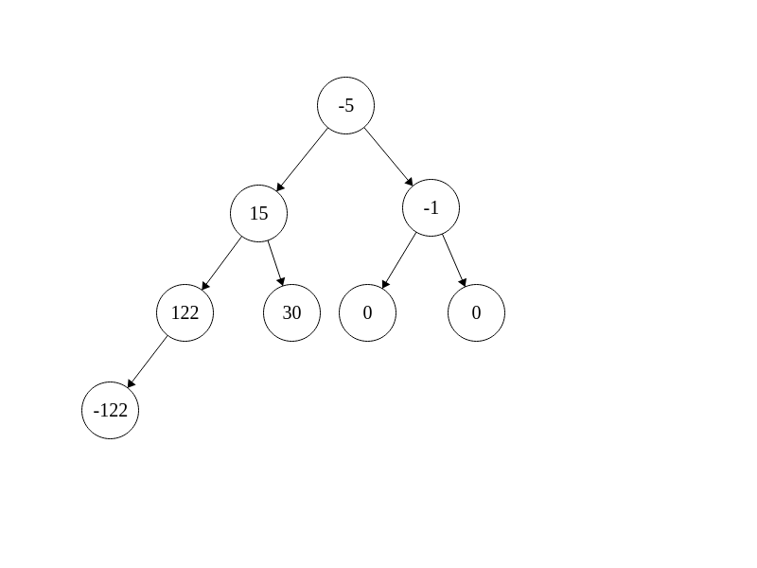
Insertion

Slide 16
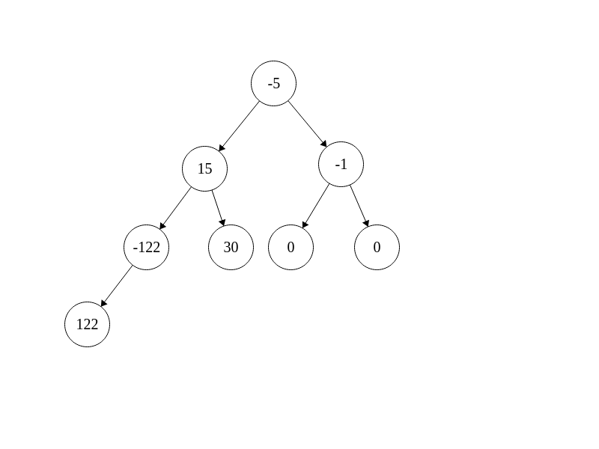
Insertion

Slide 17
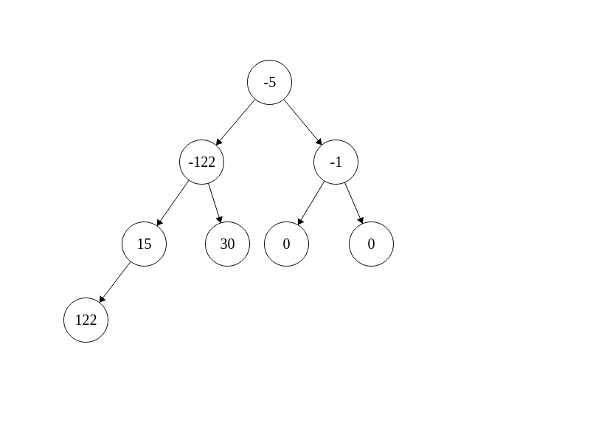
Insertion

Slide 18
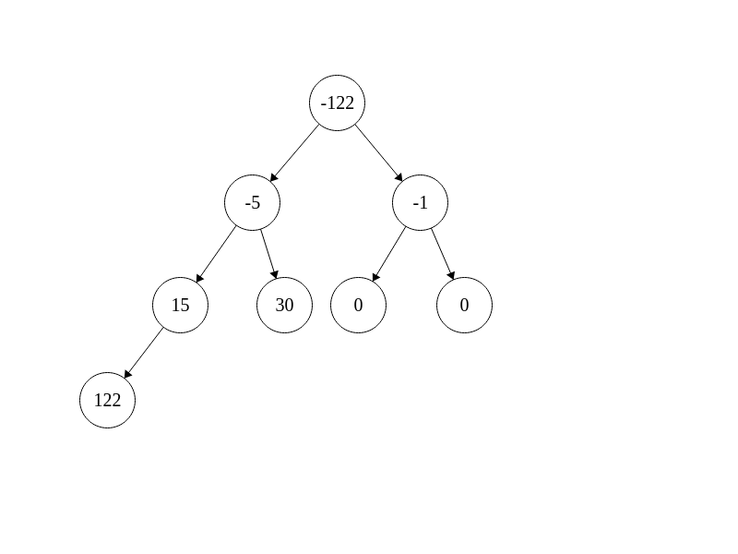
Insertion

Slide 19
Deletion
When deleting, we always want to take the highest priority element from the top

Slide 20
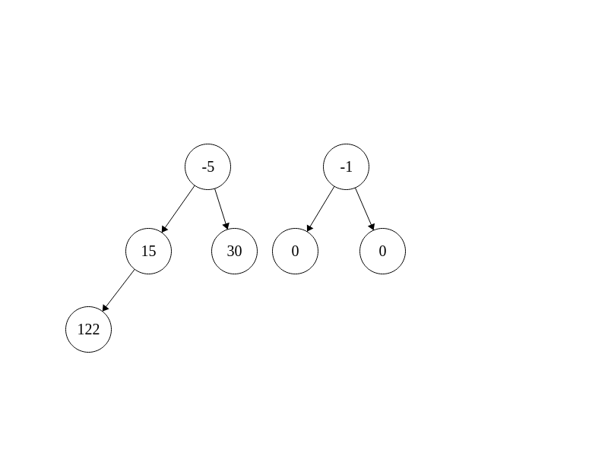
Deletion
But when we do this, we have a big problem! To fix the shape invariant, we take the last element and bring it to the top

Slide 21
Deletion
But when we do this, we have a big problem! To fix the shape invariant, we take the last element and bring it to the top

Slide 22
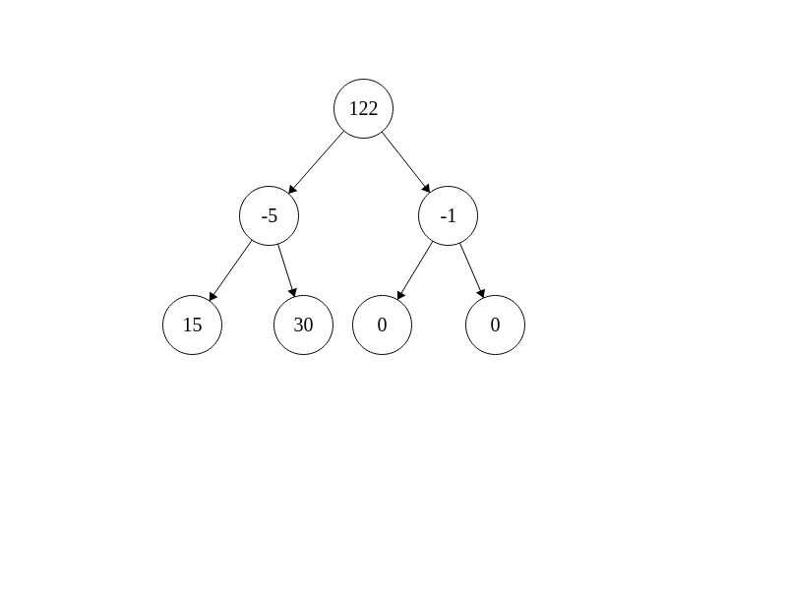
Deletion
Now we once again have an ordering violation, but in the opposite direction. Now this element is too high in the heap, and we have to sift it down.
Now there is a choice between which child to swap with though. We need to pick the child with higher priority to swap with

Slide 23
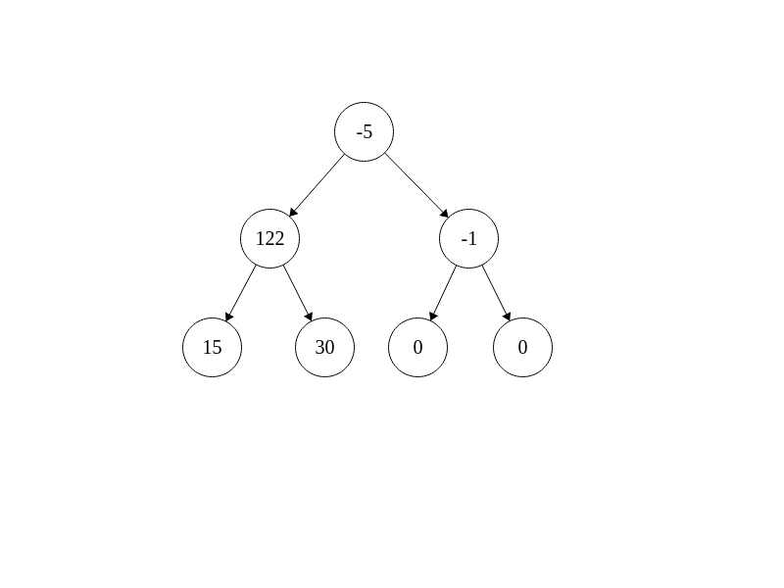
Deletion

Slide 24
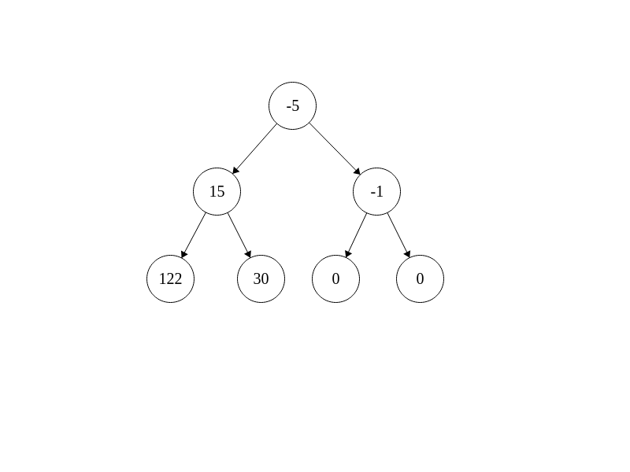
Deletion

Slide 25
Complexity
Because of the shape invariant, the heap is forced to be balanced, so its height is O(log n)
This means insertion and deletion are O(log n) worst case, since we sift up/down a single path of length O(log n).

Slide 26
Implementing heaps in code
Even though we like to visualize heaps as trees, working with all of the pointers can be annoying. We would also have to store 2 children pointers and a parent pointer. Instead, we use an array to store our heap

Slide 27
Heaps as arrays
We number the entries by going a row at a time, and across the row from left to right, starting from 1
-5
15
-1
122
30
0
0

Slide 28
Writing code for heaps
Very important relationships:
Left child of i is 2*i, right child is 2*i+1
Parent of i, if it is not the root, is i/2
Swapping 2 nodes in the tree is just swapping entries in the array
elem temp = H->data[i];
H->data[i] = H->data[i/2];
H->data[i/2] = temp

Slide 29
Writing code for heaps
Swapping loop:
while(i > 1 && (*(H->prior))(H->data[i], H->data[i/2])) {
swap_up(H,i);
i = i/2;
}

